Slide 1
School of Information Technology
ICT302
Information Technology Professional Practice Project
ITP3
Human resource Management in Project teams

Slide 2
Acknowledgement
of Country
We acknowledge that Murdoch University is situated on the lands of the Whadjuk and Binjareb Noongar people.
We pay our respect to their enduring and dynamic culture and the leadership of Noongar elders past and present.
The boodjar (country) on which Murdoch University is located has for thousands of years, been a place of learning. We at Murdoch University are proud to continue this long tradition.
Notes:
South Street
We acknowledge that Murdoch University is situated on the lands of the Whadjuk and Binjareb Noongar people.
We pay our respect to their enduring and dynamic culture and the leadership of Noongar elders past and present.
The boodjar (country) on which Murdoch University is located has for thousands of years, been a place of learning. We at Murdoch University are proud to continue this long tradition.

Slide 3
Learning Objectives
At the end of this topic you should be
able to:
Explain the importance of good human resource management on projects, especially on information technology projects
Define project human resource management and understand its processes
Summarize key concepts for managing people by understanding the appropriate theories

Slide 4
Learning Objectives
Discuss human resource planning
Assist in team development with training, team-building activities, and reward systems
Explain and apply several tools and techniques to help manage a project team
Describe how project management software can assist in project human resource management

Slide 5
The Importance of Human Resource Management
Many corporate executives have said, “People are our most important asset”
ALSO
People are commonly your most costly asset!
People determine the success and failure of organizations and projects
IT staff struggle in the transition to project management
Chief Information Officers(IT directors) complain that educational institutions are not putting adequate focus on these skills through coursework

Slide 6
The Importance of Human Resource Management
A 2006 report by:
The Conference Board Corporate Voices for Working Families Partnership for 21st Century Skills, and The Society for Human Resource Management
suggested that entry level workers in the U.S. were ill-prepared for the workplace.
The survey involved 400 employer respondents, and the following figures indicate their concerns in areas that they rated as important for entry level workers.

Slide 7
The Importance of Human Resource Management
Two–year college graduates were listed as deficient in the following skills:
Written communications – 47.3%
Writing in English – 46.4%
Four–year college graduates were listed as deficient in the following skills:
Written communications - 27.8%
Writing in English - 26.2%
Leadership - 23.8%
Note: the percentage indicates the number of respondents who observed the deficiencies

Slide 8
What is Project Human Resource Management?
Making the most effective use of the
people involved with a project
How?

Slide 9
Keys to Managing People
Psychologists and management theorists have devoted much research and thought to the field of managing people at work
Important areas related to project management include:
Motivation theories
Influence and power
Effectiveness

Slide 10
Intrinsic and Extrinsic Motivation
Intrinsic motivation causes people to participate in an activity for their own enjoyment
Extrinsic motivation causes people to do something for a reward or to avoid a penalty
For example, some children take piano lessons for intrinsic motivation (they enjoy it) while others take them for extrinsic motivation (to get a reward or avoid punishment)

Slide 11
Maslow’s Hierarchy of Needs
Abraham Maslow argued that humans possess unique qualities that enable them to make independent choices, thus giving them control of their destiny
Maslow developed a hierarchy of needs which states that people’s behaviors are guided or motivated by a sequence of needs

Slide 12
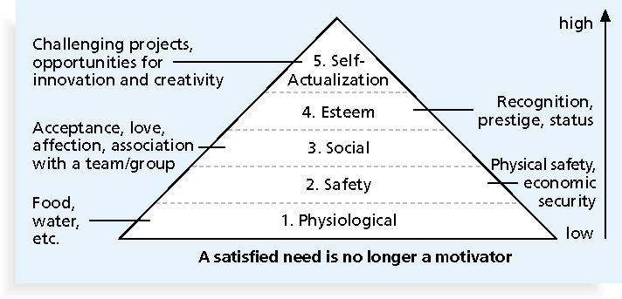
Maslow’s Hierarchy of Needs

Slide 13
Thamhain and Wilemon’s Ways to Have Influence on Projects
Authority: the legitimate hierarchical right to issue orders
Budget: the project manager's perceived ability to authorize others' use of discretionary funds
Promotion: the ability to improve a worker's position
Money: the ability to increase a worker's pay and benefits
Penalty: the project manager's ability to impose punishment
Work challenge: the ability to assign work that capitalizes on a worker's enjoyment of doing a particular task
Expertise: the project manager's perceived special knowledge that others deem important

Slide 14
Influences that Help and
Hinder Projects
Projects are more likely to succeed when project managers influence with:
Expertise
Work challenges
Promotion
Projects are more likely to fail when project managers rely too heavily on:
Authority
Money
Penalty

Slide 15
Power
Power is the potential ability to influence behaviour to get people to do things they would not otherwise do
Types of power include:
Coercive
Legitimate
Expert
Reward

Slide 16
Improving Effectiveness
Project managers can apply Stephen Covey’s 7 habits to improve effectiveness on projects
Be proactive
Begin with the end in mind
Put first things first
Think win/win
Seek first to understand, then to be understood
Synergize
Sharpen the saw

Slide 17
What is Project Human Resource Management?
Developing the human resource plan: identifying and documenting project roles, responsibilities, and reporting relationships
Acquiring the project team: getting the needed personnel assigned to, and working on, the project
Developing the project team: building individual and group skills to enhance project performance
Managing the project team: tracking team member performance, motivating team members, providing timely feedback, resolving issues and conflicts, and coordinating changes to help enhance project performance

Slide 18
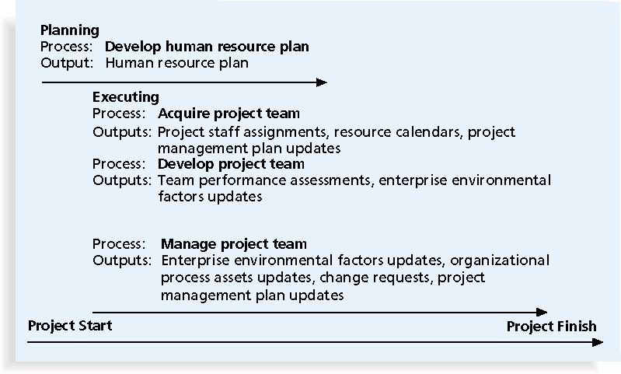
Project Human Resource Management Summary

Slide 19
Human Resource Planning
Involves identifying and documenting project roles, responsibilities, and reporting relationships
Contents of a HR plan includes:
Project organizational charts
Responsibility assignment matrices
Staffing management plan
Resource histograms

Slide 20
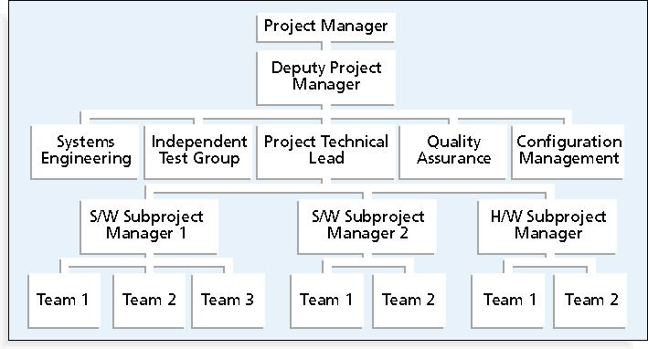
Sample Organizational Chart for a Large IT Project

Slide 21
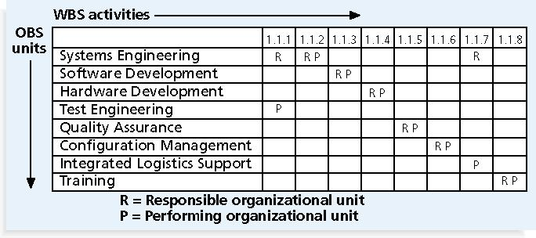
Responsibility Assignment Matrices
A responsibility assignment matrix
(RAM) is a matrix that maps the work of
the project as described in the WBS to the
people responsible for performing the work

Slide 22
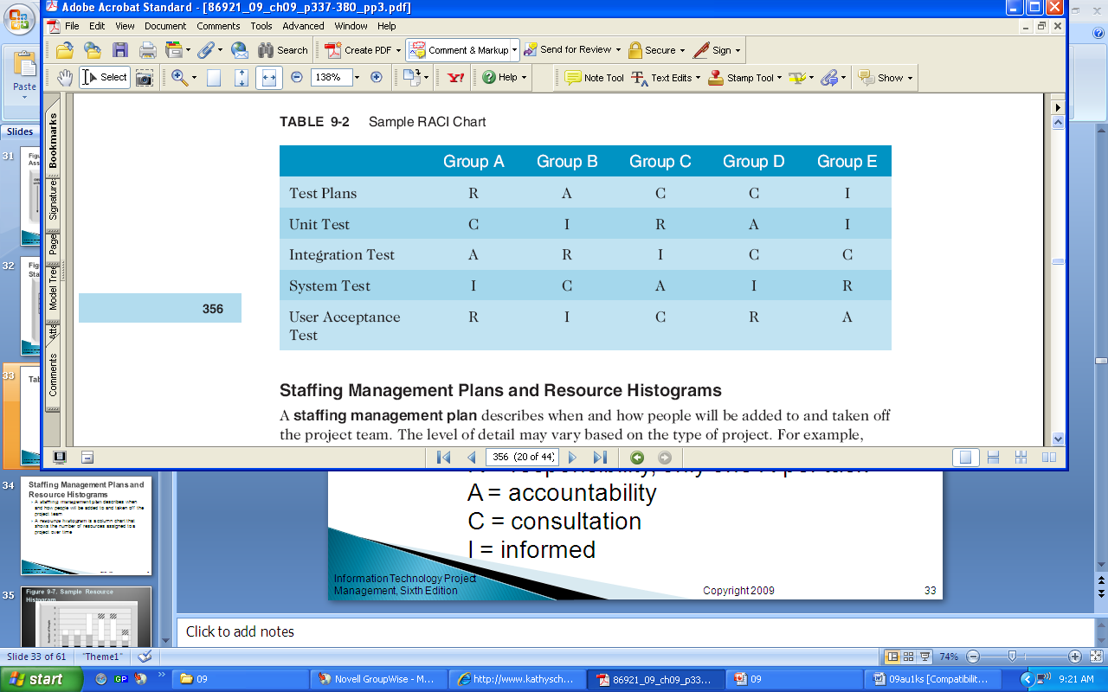
Sample RACI Chart
R = responsibility
A = accountability, only one A per task
C = consultation
I = informed

Slide 23
Staffing Management Plans
A staffing management plan describes when and how people will be added to and taken off the project team
Eg. Will show the number of C# programmers, technical writers and trainers needed, and when

Slide 24
Acquiring the Project Team
Acquiring qualified people for teams is crucial
It’s important to assign the appropriate type and number of people to work on projects at the appropriate times
Areas include:
Resource assignment
Resource loading
Resource levelling

Slide 25
Resource Assignment
Good staffing plans (aid in hiring):
Identification of skills needed, and getting people that possess these skills
Good working procedures:
Since Covid lockdowns many companies run a flexible Working From Home (WFH) and the workplace mix.
Productivity concerns not bourn out: WFH = less productivity ?

Slide 26
Resource Loading
Resource loading refers to the amount of individual resources an existing schedule requires during specific time periods
Over allocation means that more resources than are available, are assigned to perform work at a given time
As simple as giving someone too much work!

Slide 27
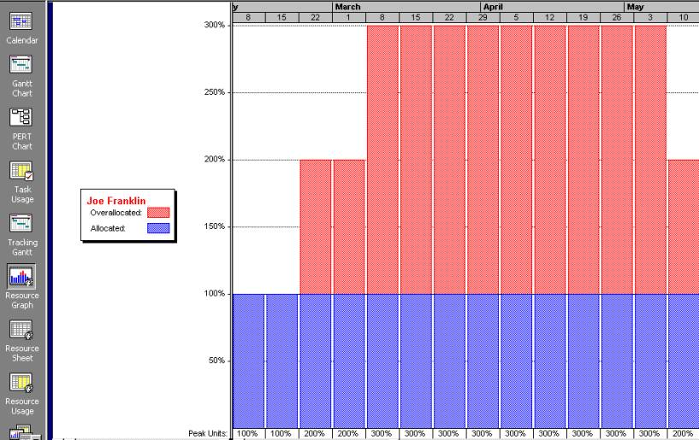
Sample Histogram Showing an Over allocated Individual

Slide 28
Resource Leveling
Resource leveling is a technique for resolving resource conflicts by delaying tasks
The main purpose of resource leveling is to create a smoother distribution of resource usage and reduce over allocation

Slide 29
Developing the Project Team
The main goal of team development is to help people work together more effectively to improve project performance
It takes teamwork to successfully complete most projects

Slide 30
Team Development
Stages of Team Development
as developed by BW Tuckman 1965, 1977
Forming
Storming
Norming
Sequential Model
Performing
Adjourning
Notes:
30

Slide 31
Forming: cautious affiliation
Time when team members become acquainted, learn about each other, and the task at hand
Marked by positive expectations, but also anxiety about what interpersonal behaviours are acceptable in the group
Eager to start on the project work
Members try to identify the task and how they should tackle it
Define and plan tasks
Lack of direction
Members will be very dependent on the leader and the reactions of other members
Notes:
31

Slide 32
Storming: competitiveness
Similar to the teenage years – turbulent!
Members may engage in arguments and vie for status in the group
Application of skills to assigned tasks
Work begins to progress slowly
Conflicts emerge and tension may increase
More questions about roles, responsibilities, procedures
The lack of unity is an outstanding feature of this phase
Notes:
32

Slide 33
Norming: harmonious cohesion
Relationships stabilise
Group members establish rules about how they will achieve their goal
They address the types of communication that will or will not help with the task
Conflicts for the most part have been resolved
Group members start to accept each other and group norms will develop
Trust begins to develop as team members confide in one another
Development of group cohesion
Notes:
33

Slide 34
Performing: collaborative teamwork
Characterized by constructive attempts at successful task completion
Highly committed
Level of work performance is high
Team feels a sense of unity and pride in its accomplishments
Great degree of interdependency and collaboration
Adjournment – final stage
Notes:
34

Slide 35
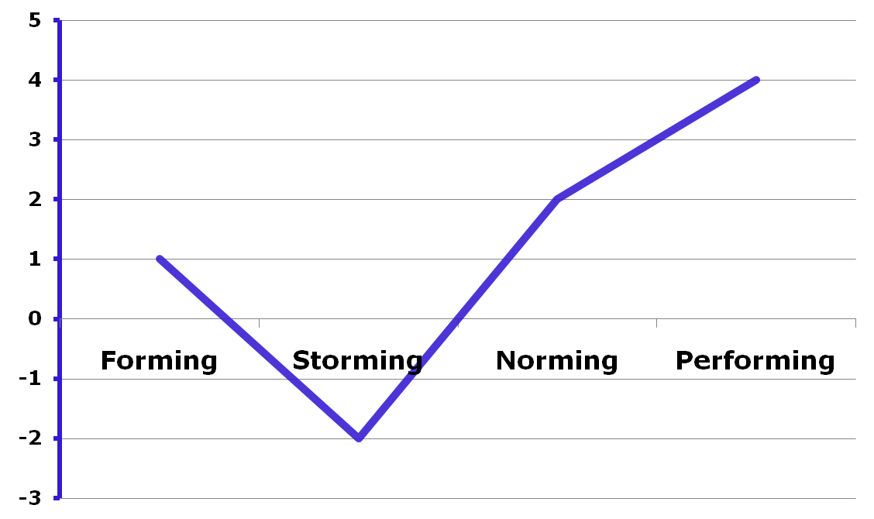
Productivity & Team Stages
Time

Slide 36
Training
Training can help people understand themselves, each other, and how to work better in teams
Team building activities include:
Physical challenges
Psychological preference indicator tools

Slide 37
Meyers-Briggs Type Indicator (MBTI)
MBTI is a popular tool for determining personality preferences and helping teammates understand each other
Four dimensions include:
Extrovert/Introvert (E/I)
Sensation/Intuition (S/N)
Thinking/Feeling (T/F)
Judgment/Perception (J/P)
NTs or rationals are attracted to technology fields
IT people vary most from the general population in not being extroverted or sensing
Eg: Determine your style!

Slide 38
Social Styles Profile
People are perceived as behaving primarily in one of four zones, based on their assertiveness and responsiveness:
Drivers
Expressives
Analyticals
Amiables
People on opposite corners (drivers and amiables, analyticals and expressives) may have difficulties getting along

Slide 39
Reward and Recognition Systems
Team-based reward and recognition systems can promote teamwork
Focus on rewarding teams for achieving specific goals
Allow time for team members to mentor and help each other to meet project goals and develop human resources

Slide 40
Managing the Project Team
Project managers must lead their teams in performing various project activities
After assessing team performance and related information, the project manager must decide:
If changes should be requested to the project
If corrective or preventive actions should be recommended
If updates are needed to the project management plan or organizational process assets

Slide 41
Tools and Techniques for Managing Project Teams
Observation and conversation
Project performance appraisals
Conflict management
Issue logs
Interpersonal skills

Slide 42
General Advice on Teams
Be patient and kind with your team
Fix the problem instead of blaming people: focus on behaviour
Establish regular, effective meetings:
Focus on objectives and positive results
Allow time for teams to go through the basic team-building stages
Limit the size of work teams to between three and seven members
Plan social activities:
Fun but not mandatory

Slide 43
Five Dysfunctions of a Team
*Lencioni, Patrick, “Overcoming the Five Dysfunctions of a Team,” Jossey-Bass: San Francisco, CA (2005), p. 3.
Patrick Lencioni: “Teamwork remains the one sustainable competitive advantage that has been largely untapped”*
The five dysfunctions of teams are:
Absence of trust
Fear of conflict
Lack of commitment
Avoidance of accountability
Inattention to results

Slide 44
Using Software to Assist in Human Resource Management
Project management software includes several features related to human resource management such as:
Assigning resources
Identifying potential resource shortages or under utilizations
Leveling resources

Slide 45
Project Resource Management Involves Much More Than Using Software
Project managers must:
Treat people with consideration and respect
Understand what motivates them
Communicate carefully with them
Focus on your goal of enabling project team members to deliver their best work

Slide 46
Peter Cole
p.cole@Murdoch.edu.au
0417 097 914

